Slide 1
Predicting Condition Flare Up in Patients with Respiratory Disease History
By Sachin Jain, Basavaraju & Manish

Slide 2
Feature Selection
It is supervised model. It has labeled data (Flare-Up)
Training data has 60 Features to predict target.
Select the Feature to avoid overfitting or not impacted features.
Following features selection algorithms applied to select features(32 out of 60).
f_regression
f_classif
Chi-Squre
RFECV
L1-Based
Tree-based

Slide 3
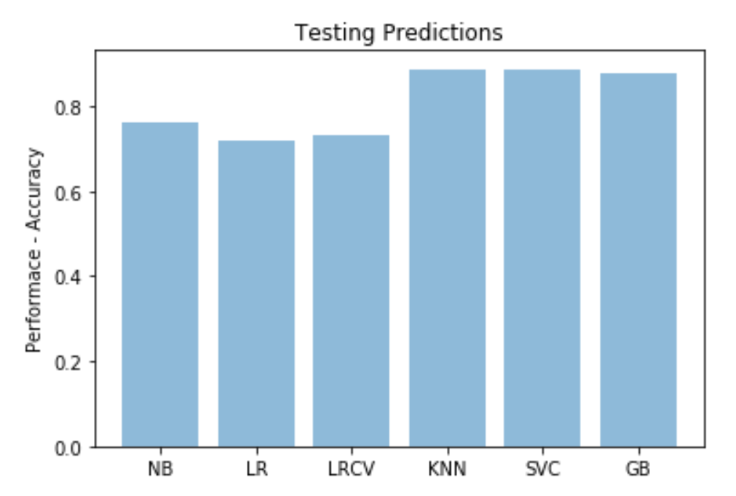
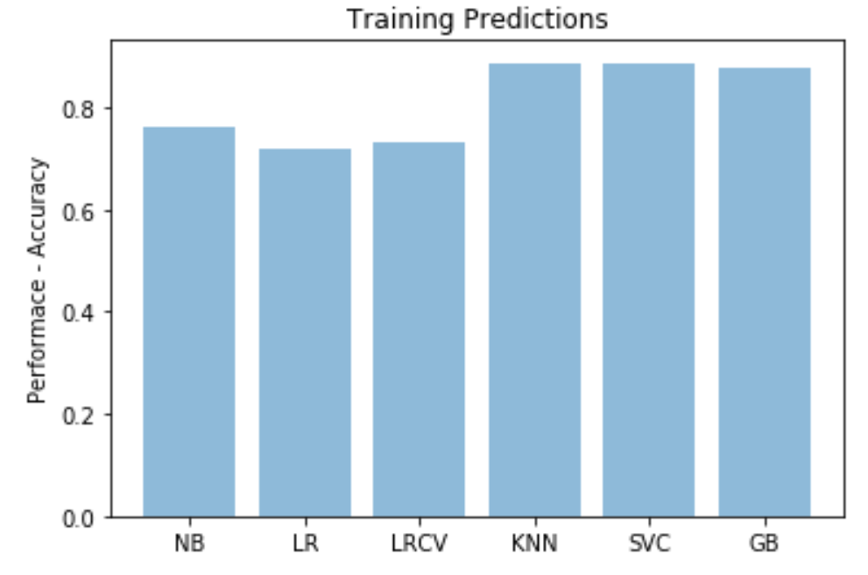
Predict the training and testing data accuracy
Get Predictions from the algorithms
Calculate Training and Testing data accuracy for each algorithm.
Calculate matrix – Confusion metrix and classification reports.
Algorithms -
Naïve Bayes
Logistic Regression
Logistic Regression CV
KNN
SVC
Gradient Boosting Classifier

